Slide 1

Leveraging Housing Sales Data to Build Accurate Price Prediction Models for Realtors and Agents
Using data to enhance real estate pricing accuracy
Notes:
AI-generated content may be incorrect. --- This presentation focuses on how housing sales data can be leveraged to develop accurate price prediction models that help realtors and agents make informed decisions. We will explore the importance of data-driven pricing, data collection and preparation, model development, practical applications, and future enhancements. Image source: Microsoft 365 content library

Slide 2

Why Accurate Price Prediction Matters in Real Estate
Maximizing Profit
Accurate price prediction helps properties sell at their ideal value, maximizing returns for sellers.
Reducing Market Time
Proper pricing reduces the time properties remain unsold, speeding up transactions.
Building Client Trust
Accurate pricing builds strong relationships and trust between agents and clients.
Strategic Market Insights
Accurate price data supports informed recommendations and strategic decision-making.
Notes:
--- Accurate pricing ensures properties sell at the right value, maximizing profit and reducing time on market. It helps agents build trust with clients and make strategic recommendations based on market insights. Image source: Microsoft 365 content library

Slide 3

Challenges Faced by Realtors and Agents without Predictive Tools
Reliance on Intuition
Agents depend on gut feelings or outdated data, increasing the risk of errors in pricing and decision-making.
Missed Opportunities
Lack of predictive insights causes agents to overlook potential deals and emerging market trends.
Market Volatility Challenges
Rapid changes in the market make it difficult to keep up without advanced data analysis tools.
Data Overload Complexity
Vast amounts of real estate data overwhelm agents, hampering effective decision-making and client service.
Notes:
--- Without predictive tools, agents rely on intuition or outdated information, leading to pricing errors, missed opportunities, and inconsistent client experiences. Market volatility and vast data volumes add to the complexity. Image source: Microsoft 365 content library

Slide 4

Benefits of Data-Driven Decision Making
Objective Pricing Strategies
Data-driven approaches allow businesses to set pricing based on market trends and historical data objectively.
Enhanced Client Satisfaction
Using data insights helps tailor services and products, leading to improved client satisfaction and loyalty.
Optimized Marketing Strategies
Leveraging data optimizes marketing campaigns to effectively reach target audiences and improve ROI.
Competitive Advantage
Data-driven insights provide businesses with an edge over competitors by anticipating market changes.
Notes:
--- Data-driven decisions enable objective pricing, improve client satisfaction, optimize marketing strategies, and provide competitive advantage by leveraging extensive market trends and historical data. Image source: Microsoft 365 content library

Slide 5

Sources of Housing Sales Data
Public Records
Public records provide official information on property transactions accessible to the general public.
Real Estate Listings
Real estate listings offer current housing sales data from various agents and agencies.
MLS Databases
Multiple Listing Service databases consolidate sales information from multiple real estate professionals.
Government and Commercial Data
Government datasets and commercial providers enrich the data with comprehensive housing market insights.
Notes:
--- Housing sales data can be sourced from public records, real estate listings, MLS databases, government datasets, and commercial providers. Combining multiple sources enhances data comprehensiveness. Image source: Microsoft 365 content library

Slide 6

Key Features and Variables Affecting Pricing
Property Physical Attributes
Size, age, and number of rooms directly impact the property's market value and buyer appeal.
Location and Neighborhood Amenities
Location quality and local amenities shape desirability, influencing pricing in real estate markets.
Market and Economic Factors
Current market trends and economic indicators significantly affect property prices and sales dynamics.
Notes:
--- Important variables include property size, location, age, number of rooms, neighborhood amenities, market conditions, and economic indicators, all influencing the sale price significantly. Image source: Microsoft 365 content library

Slide 7

Data Cleaning and Preprocessing Techniques
Handling Missing Values
Imputing missing data is essential to maintain dataset integrity before analysis.
Removing Duplicates
Removing duplicate entries ensures accuracy by preventing bias in the dataset.
Feature Normalization
Normalizing features standardizes data ranges, improving model performance.
Categorical Encoding
Encoding categorical variables converts text data into numerical format for modeling.
Notes:
--- Raw data often contains inconsistencies, missing values, and outliers. Techniques like removing duplicates, imputing missing data, normalizing features, and encoding categorical variables prepare the data for modeling. Image source: Microsoft 365 content library

Slide 8

Model Training, Validation, and Evaluation Metrics
Model Training Process
Models learn patterns from historical data to make predictions on new data accurately.
Validation Techniques
Separate datasets are used to validate models and prevent overfitting for reliable results.
Evaluation Metrics
Metrics like MAE, MSE, and R-squared quantify the accuracy and performance of predictive models.
Notes:
--- Models are trained on historical data, validated with separate datasets, and evaluated using metrics like mean absolute error (MAE), mean squared error (MSE), and R-squared to measure prediction accuracy. Image source: Microsoft 365 content library

Slide 9

Integrating the Model Into Realtor Workflows
Embedding Prediction Tools
Integrate prediction tools directly into CRM systems and property listing platforms for seamless access.
Easy Access to Pricing Insights
Agents can quickly retrieve accurate pricing information to support decision-making and client advising.
Enhanced Client Interactions
Incorporating pricing insights into conversations improves client trust and sales effectiveness.
Notes:
--- Embedding prediction tools into CRM systems or property listing platforms helps agents access pricing insights easily and incorporate them into client interactions. Image source: Microsoft 365 content library

Slide 10
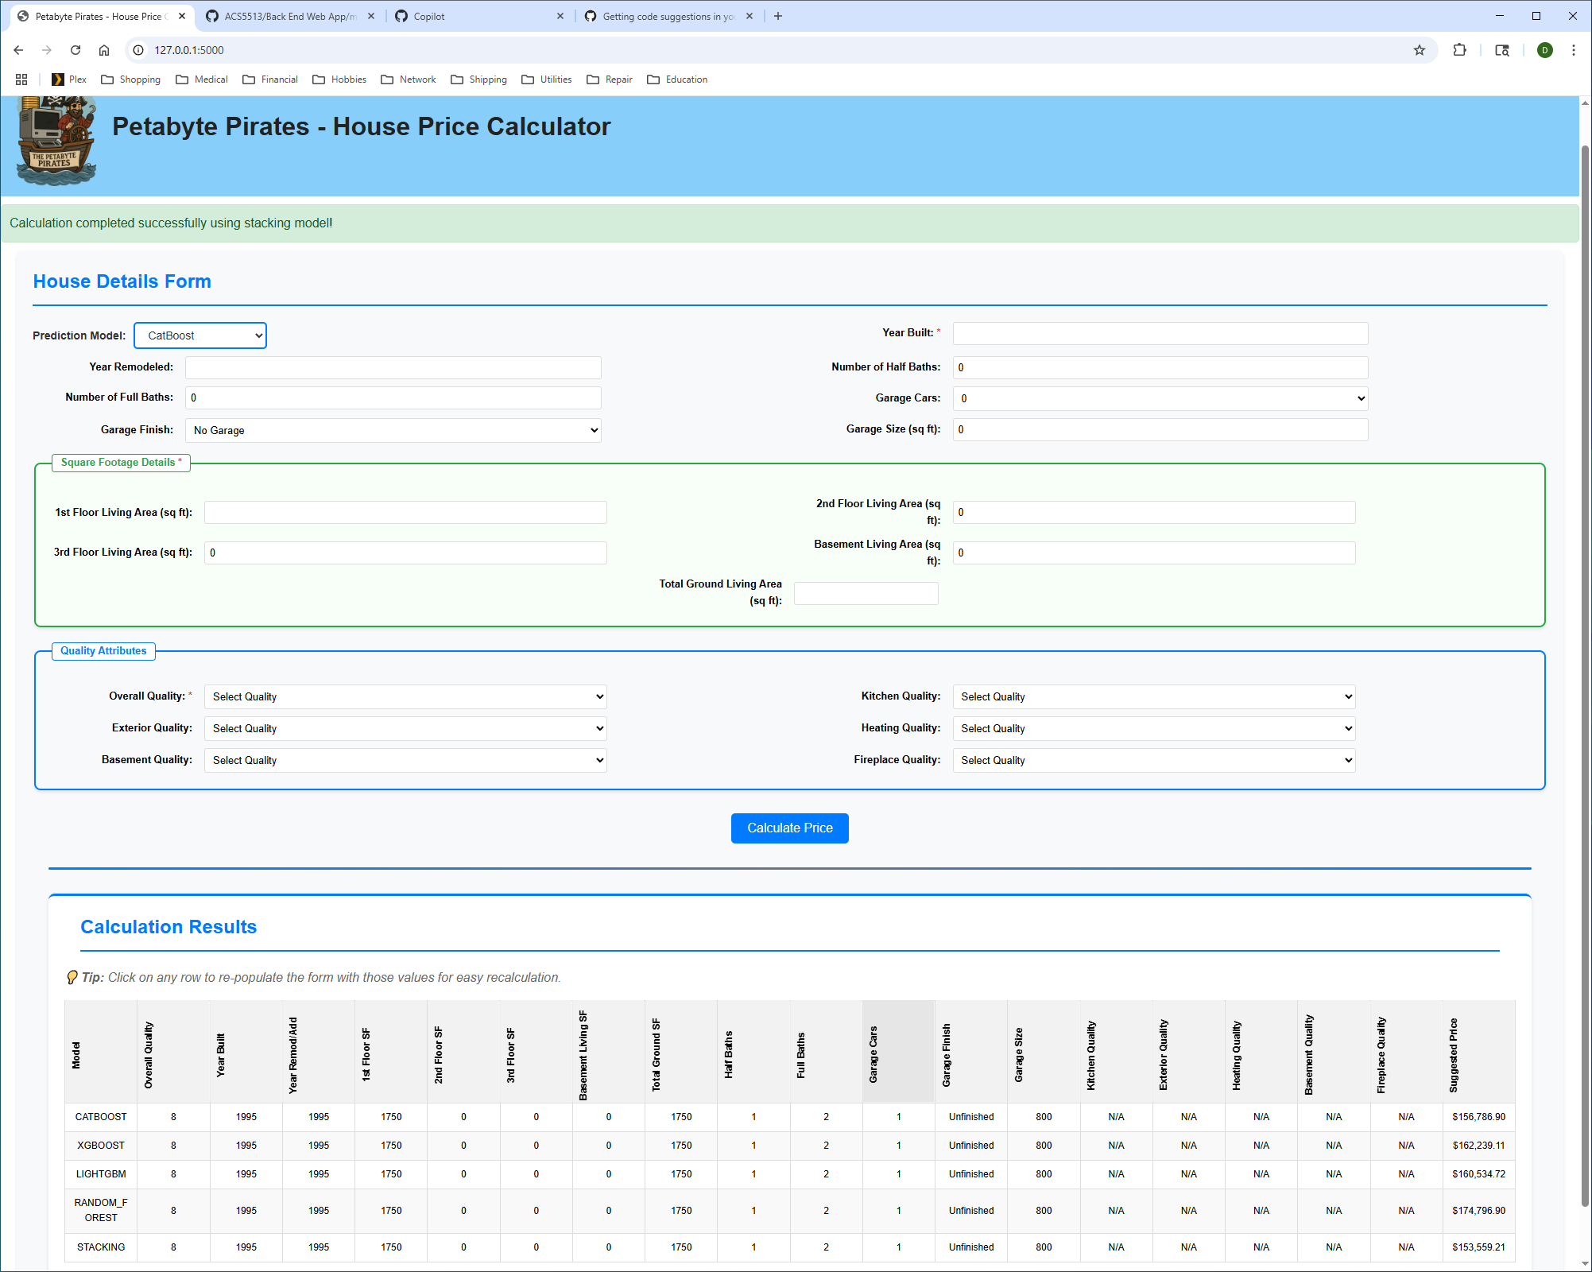
Visualizing and Interpreting Predictions
Predicted Prices Visualization
Provide history of predictions with the ability to replay and adjust scenarios to do what-if analysis
Feature Importance Insight
Visualizations highlight key features influencing predictions, aiding agents in interpretation.
Notes:
--- Clear visualizations such as charts and dashboards enable agents to understand predicted prices, feature importance, and confidence intervals, facilitating better decision-making. Image source: Microsoft 365 content library

Slide 11

Limitations and Considerations for Practical Use
Model Limitations
Models can be affected by data bias, market fluctuations, and unique property characteristics.
Importance of Local Expertise
Agents should integrate local market knowledge with model outputs for better decision-making.
Notes:
--- Models may face limitations like data bias, market changes, and unusual property features. Agents should complement model outputs with local expertise and updated market knowledge. Image source: Microsoft 365 content library

Slide 12
Conclusion
Data-Driven Pricing
Using housing sales data helps realtors price properties more accurately and competitively in the market.
Informed Decision Making
Predictive models provide realtors and agents with insights to make better decisions for clients.
Enhanced Competitiveness
Adopting data-driven approaches boosts competitiveness and improves client satisfaction in real estate.
Notes:
Leveraging housing sales data and predictive models offers realtors and agents powerful tools to price properties accurately and make informed decisions. Embracing data-driven approaches enhances competitiveness and client satisfaction in the evolving real estate market.

